Slide 1


HealthCare Performance Dashboard & ChatBot

Slide 2
Project Team
Kashinath Konade
Sujana Billava

Slide 3
Data Requirement
Operator Module Analytics
Physician Module Analytics
Examples of operational insights may include:
Resource management (e.g., bed occupancy rates, equipment utilization)
Financial tracking (e.g., cost per patient, revenue cycle efficiency)
Operational performance (e.g., average wait times, throughput analysis)
Patient experience (e.g., satisfaction scores, complaint resolution times)
Examples of clinical insights may include:
Patient outcomes (e.g., recovery rates, readmission statistics)
Treatment efficacy (e.g., protocol adherence, intervention success rates)
Quality measures (e.g., infection rates, adverse event tracking)
Resource optimization (e.g., diagnostic test utilization, procedure scheduling)advanced

Slide 4
Dashboard Requirement
Interactive visualization of key performance indicators
Role-specific views for physicians and operators
Real-time performance tracking and trend analysis
Customizable data displays and reporting tools
GenAI-Powered Digital Assistant
Conversational interface for natural language queries
Intelligent analysis of performance metrics
Contextual explanations of trends and anomalies
Personalized insights based on user role and preferences

Slide 5



Dataset Creation for Advanced Healthcare Analytics
Define key areas of focus:
Operator Module Analytics: Resource management, financial tracking, operational performance, patient experience.
Physician Module Analytics: Patient outcomes, treatment efficacy, quality measures, resource optimization.
Explain how ChatGPT can be used:
Generating Python code snippets for dataset creation.
Drafting schemas for simulated or real-world healthcare datasets.
Example workflow:
Input: Prompt ChatGPT with dataset requirements.
Output: Code for creating structured data, such
Steps in Python Implementation:
Install necessary libraries like pandas, numpy, faker ect.
Use Python to create structured datasets (e.g., patient records, shift schedules).
Perform checks to ensure the dataset adheres to domain requirements (e.g., correct date formats, valid patient IDs).
Save the dataset in CSV, Excel, or a database format for further analysis.

Slide 6
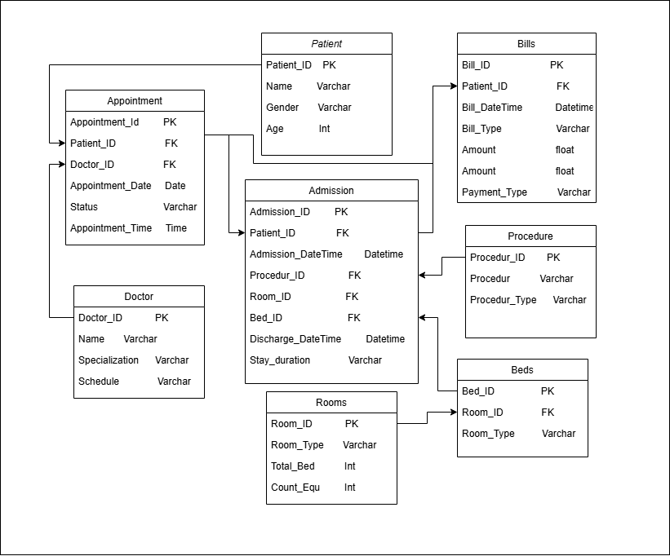
Data Set Architecture
Based on requirement Create this Architecture using draw.io
Table Name:
Appointment
Admission
Patient
Procedure
Doctor
Rooms
Beds
Bills

Slide 7
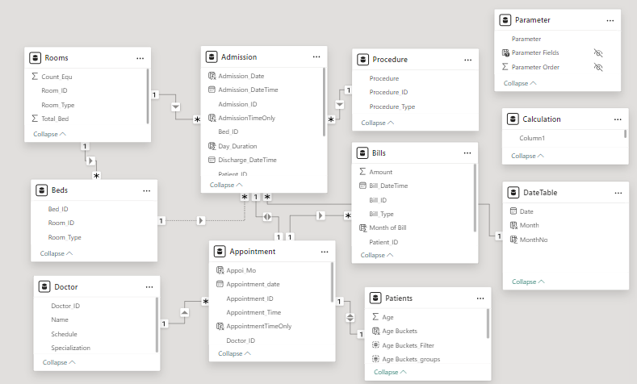
Power BI Desktop
Create Relationship between Tables

Slide 8
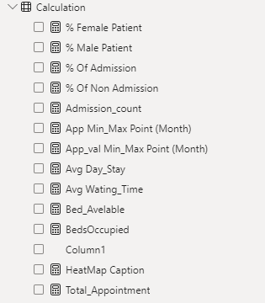
Power BI Desktop
Created DAX Functions :
% Female Patient: Percentage of female patients.
% Male Patient: Percentage of male patients.
% Of Admission: Percentage of patients admitted.
% Of None Admission: Percentage of patients not admitted.
Admission_count: Total number of admissions.
App Min_Max Point (Month): Minimum or maximum appointment values by month.
App_val Min_Max Point (Month): Minimum or maximum appointment values (likely numeric).
Avg Day_Stay: Average length of stay for admitted patients.
Avg Waiting_Time: Average patient wait time.
Bed_Available: Count of available beds.
BedsOccupied: Count of beds currently occupied.
HeatMap Caption: Label or annotation for a heatmap visualization.
Total_Appointment: Total number of appointments.

Slide 9
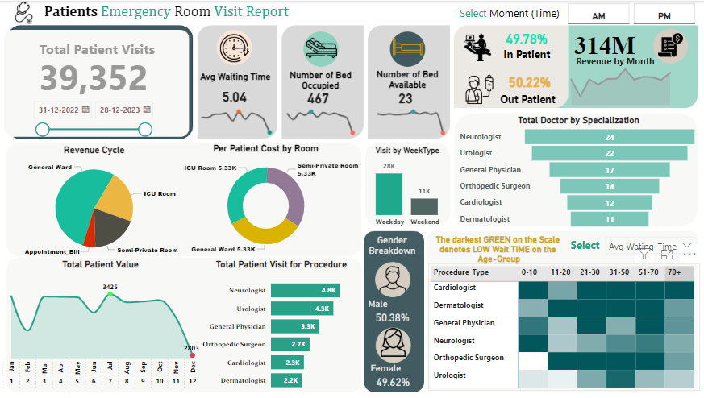
Power BI Dashboard

Slide 10
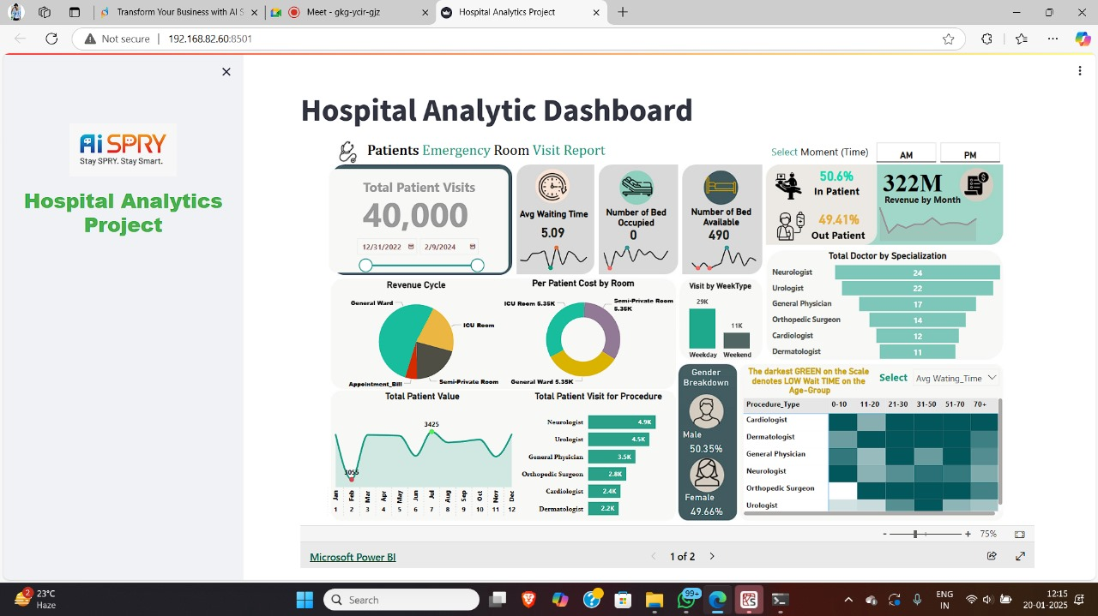
Embed Report to Streamlit

Slide 11
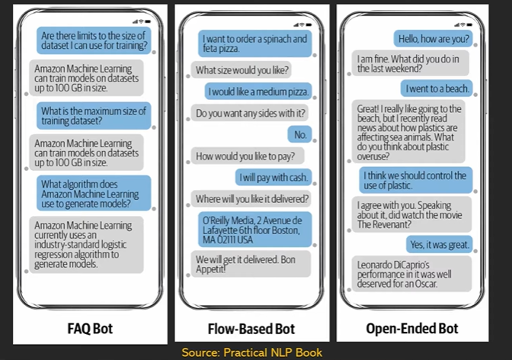
Research About Chat Bot
Types of Chat Bot

Slide 12
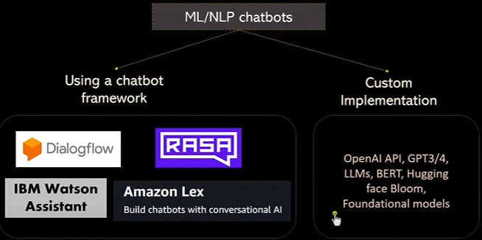
Research About Chat Bot

Slide 13
Research About Chat Bot (NLP vs LLM)
Feature | NLP Chatbots | LLM-based Chatbots
Language Understanding | Limited to predefined intents and keywords. | Extensive, with contextual understanding.
Context Retention | Minimal or none across conversations. | Retains and uses context effectively.
Flexibility | Requires manual updates for new intents. | Adapts dynamically to diverse queries.
Training Data | Needs curated, domain-specific datasets. | Pre-trained on massive, diverse datasets.
Examples | Dialogflow, Rasa | ChatGPT, Bard, Claude

Slide 14
When to Use an LLM for Tabular Data
User-Friendliness: You want a conversational interface for querying and analyzing data.
Insights Generation: You need narrative summaries or explanations from the data.
Automation: You aim to reduce manual effort in querying or reporting.
Unstructured to Structured Conversion: You have textual data that needs mapping or enrichment with tabular data.
Chaining Queries and Workflows
LangChain allows you to build complex workflows where the output of one query can feed into another.
Example:
Extract insights from a tabular dataset ("What are the top-performing sales regions?").

Slide 15
What is LangChain ?
LangChain is a framework designed to simplify working with large language models (LLMs) like OpenAI's GPT. It is especially useful when building applications that involve natural language understanding, structured data processing, and conversational AI. Here's how LangChain can be leveraged in the context of LLMs for tabular data and NLP chatbots.

Slide 16
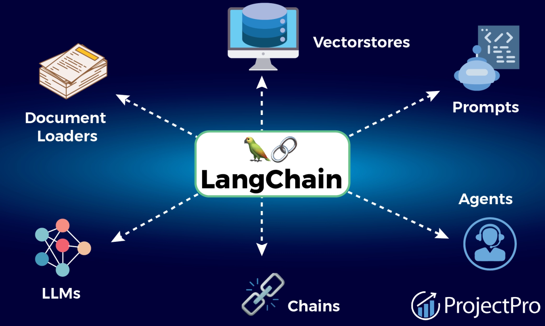
Why LangChain !
What LangChain can do?
Build applications
Improve model accuracy
Integrate with external data
Compare prompts and foundation models
Advantages of Using LangChain
Modular: Simplifies adding tools like SQL connectors, search engines, or APIs.
Efficient Prompt Management: Helps craft and reuse prompts for consistent results.
Scalable: Works well with both small-scale prototypes and production-level applications.
Customizable: Fine-tune workflows, integrate domain-specific knowledge, and enhance model outputs.

Slide 17

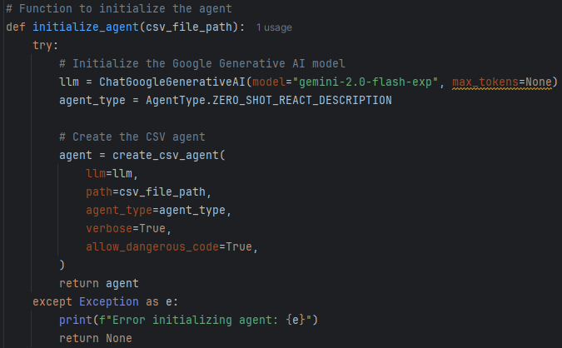
Initialize_Agent to out Mode
Key Features
Google Generative AI Integration: Uses the Gemini 2.0 model for natural language processing.
CSV Agent: Processes CSV data using LangChain's create_csv_agent functionality.
Interactive Querying: Users can ask questions about the CSV data in natural language.
Zero-Shot React Description: Implements a zero-shot approach to understand and generate responses based on the CSV content.

Slide 18
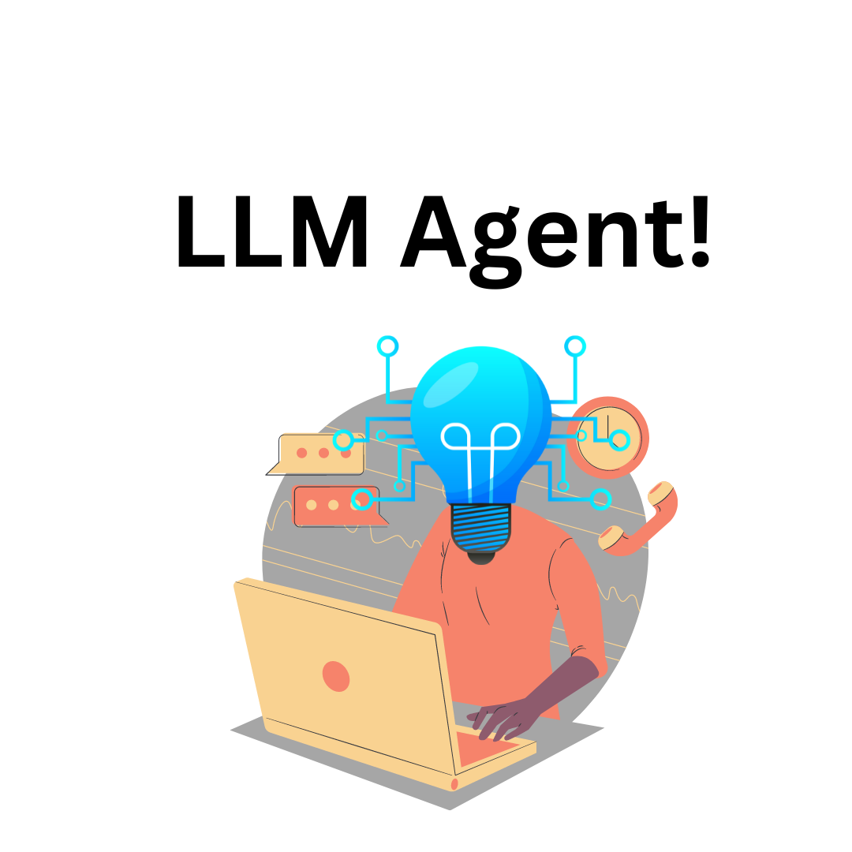

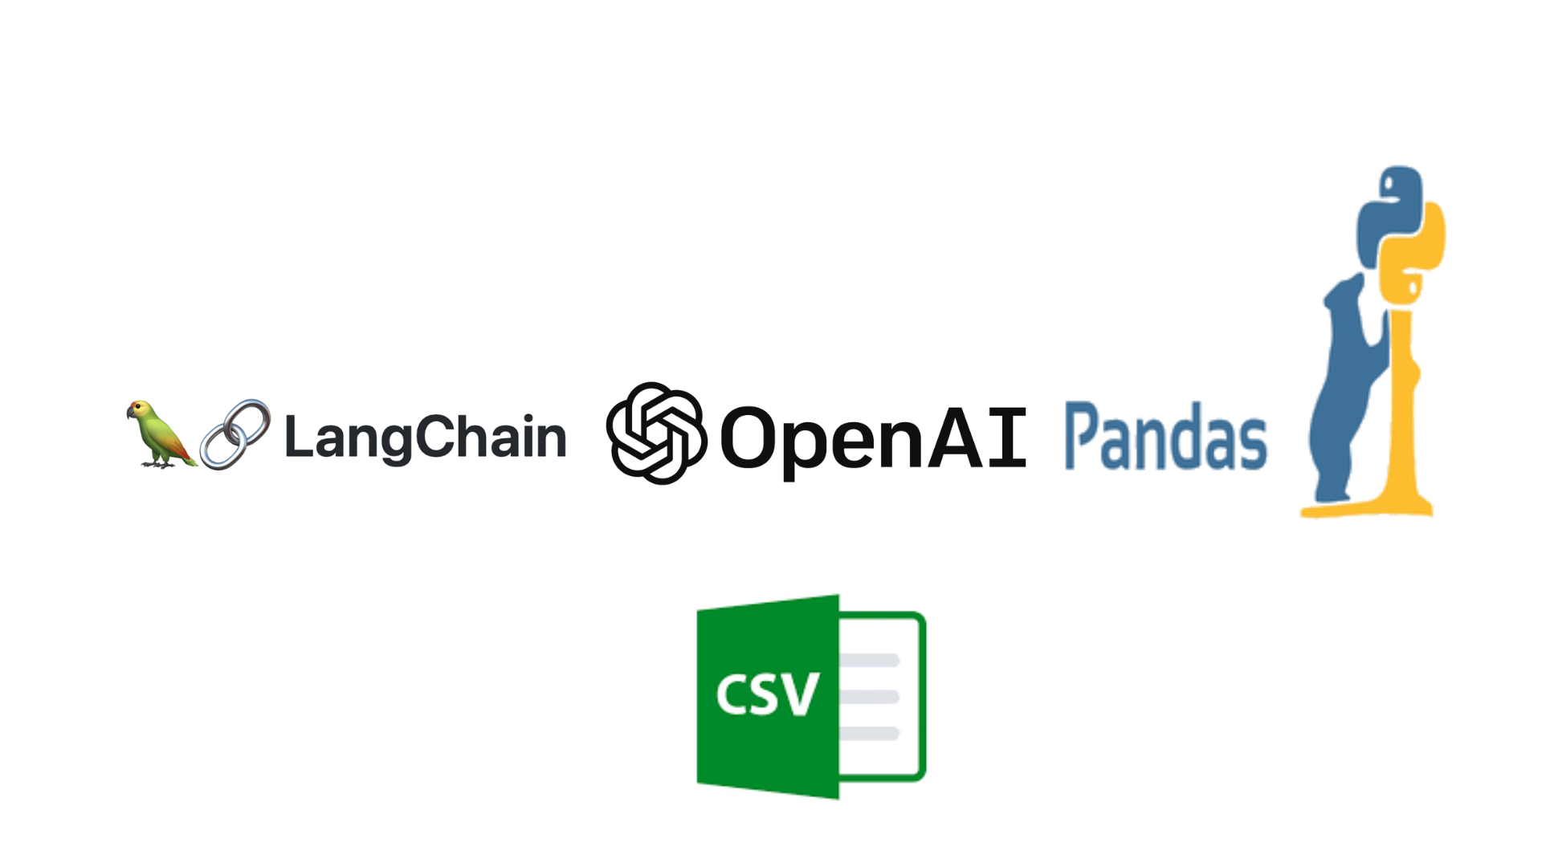

What CSV Agent Will Does
Take LLM Model : Model for natural language processing, because the LLM acts as the reasoning and decision- making engine. The LLM enables agents to interpret input, make decisions
2. Load the CSV File
The agent reads the CSV file specified by the csv_file_path.
It loads the contents into a structured format (typically using Pandas under the hood).
3. Take Agent Type : The Zero-Shot ReAct agent is a powerful way to handle diverse and dynamic tasks without requiring predefined logic, leveraging the flexibility and reasoning power of LLMs.

Slide 19
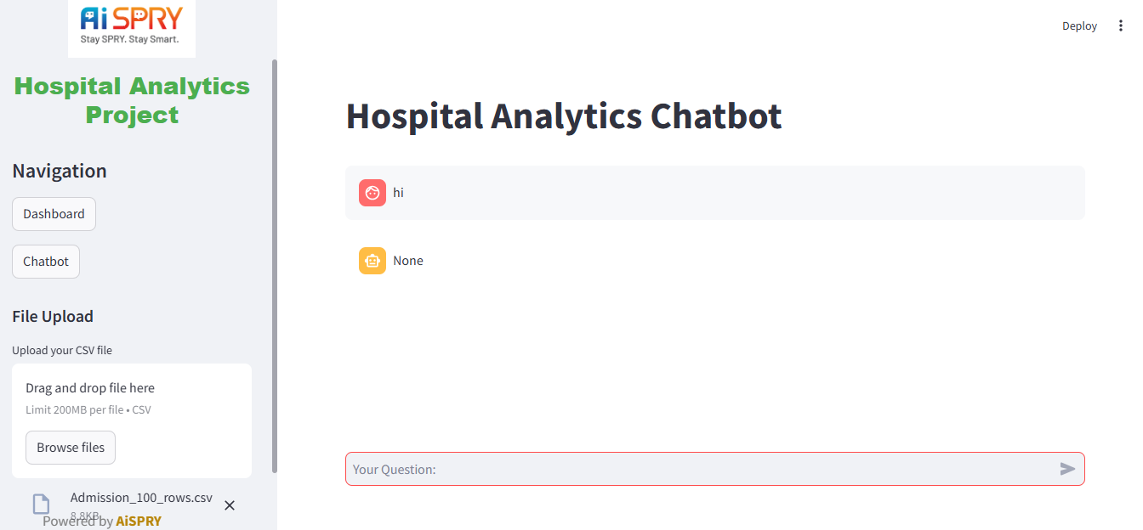
Our Hospital Analytics Chatbot

Slide 20


